Slide 1

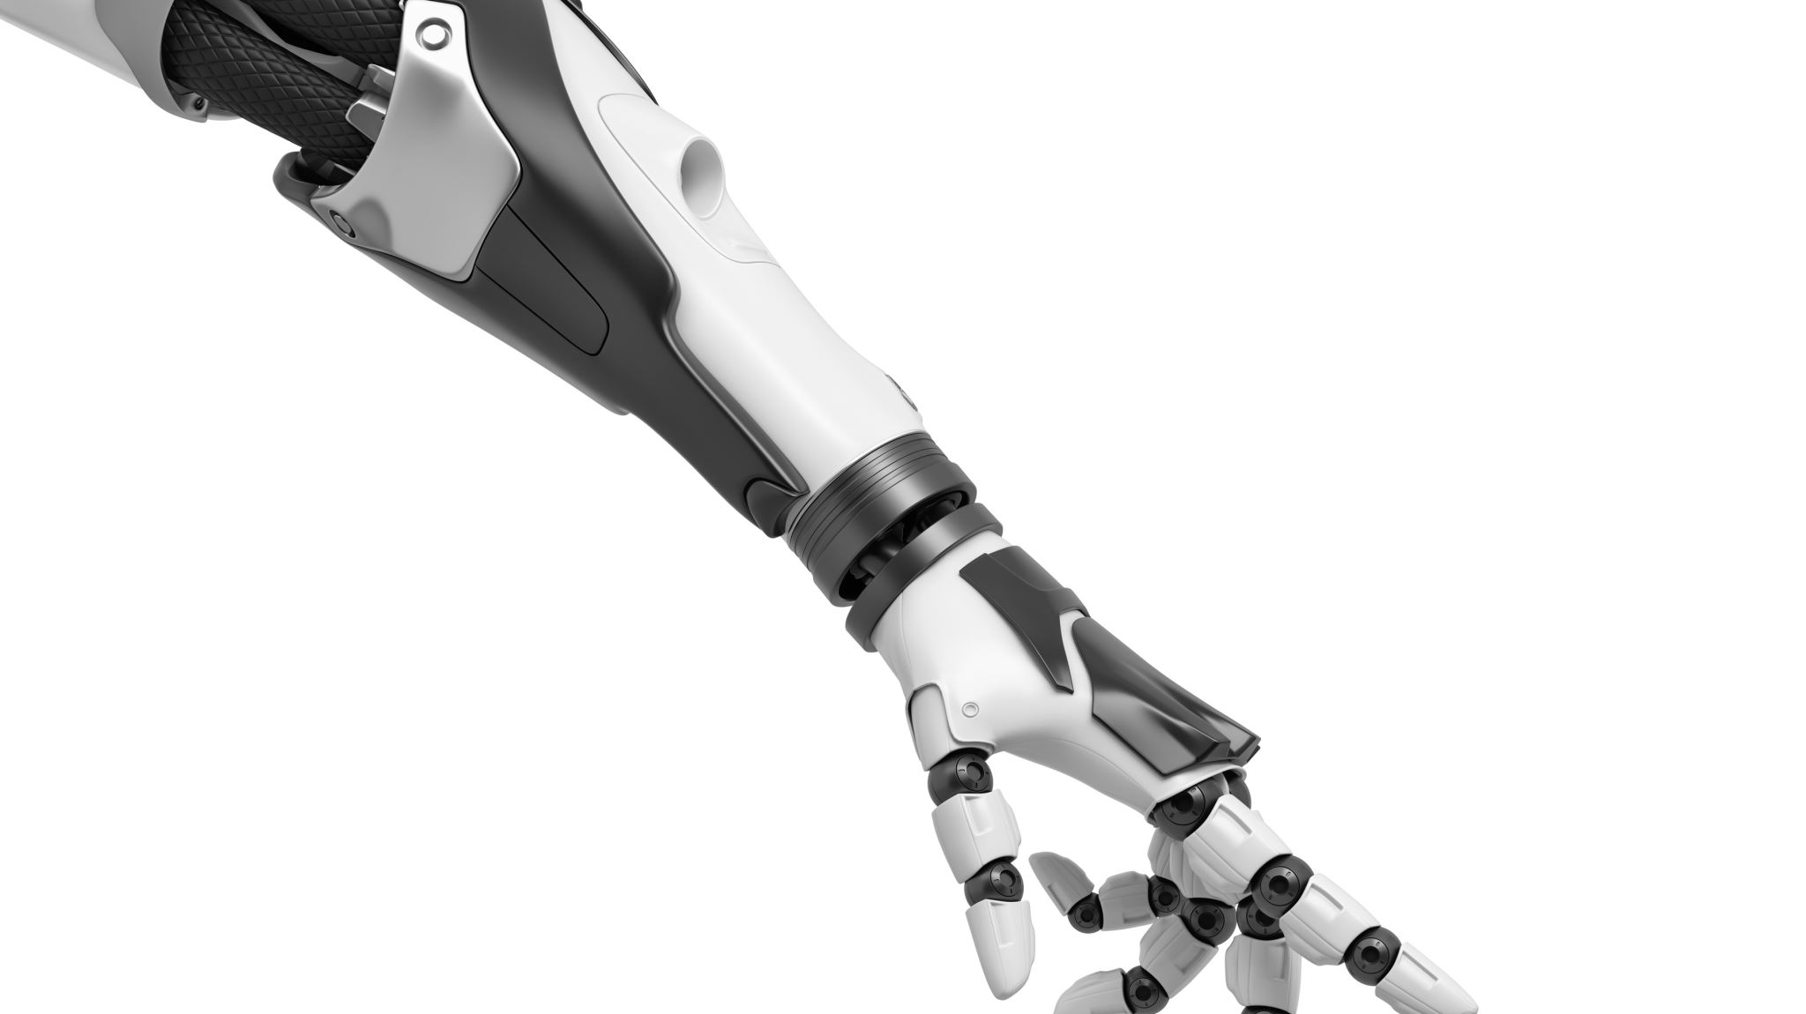
Robotic Vehicle Controlled Through Touchscreen-based Device
Team:
Yousef Albatel and Well Moua
Advisor:
Dr. Reza Khani

Slide 2





Introduction
Yousef Albatel
Well Moua
Major:
Electrical/Electronic Engineering
Hometown:
Kuwait City
Project Manager
Major:
Computer Engineering
Hometown:
Oroville, CA
Faculty advisor:
Dr. Reza Khani

Slide 3
Background
The Problem:
The police and fire department might not having enough manpower.
The police and fire department might be put in dangerous situations:
Search and rescue missions
Scout dangerous scenes or enter a building on fire.
The Solution:
A robotic vehicle equipped with a camera controlled via touchscreen-based device.
Controlled remotely Keeping the user safe.
Providing real-time visual feedback.

Slide 4
Background Problem definition
Customer Requirements
The robotic vehicle must be controlled via a touchscreen-based device.
The vehicle should move forward, backward, left, and right.
The maximum operational range of the robotic vehicle should be 200 meters.
The touchscreen device will be connected to the transmitter, while the microcontroller will be connected to the receiver at the vehicle’s end.
Should have or be nice to have:
Add sensors on the robot to know directions and hazards around it.
Limited autonomous driving for robotic vehicle.
A noise feedback when the robotic vehicle detects an object or something in its path.

Slide 5
Engineering specifications
Requirement | Engineering Specifications | Metrics | Method | Condition | Targets
Weight | mass | lbs | scale | inclusive all parts | >= 8 lbs
Battery life | watts | power and hours used | power and hours used | continues use | >= 3 hrs
Speed | mph | miles per hour |  | when moving forward | 2.5-3 mphs
Distance before disconnecting | meters | meters moved before disconnecting | moving the vehicle forward until it disconnects from the touch screen | continues use | 200 meters

Slide 6

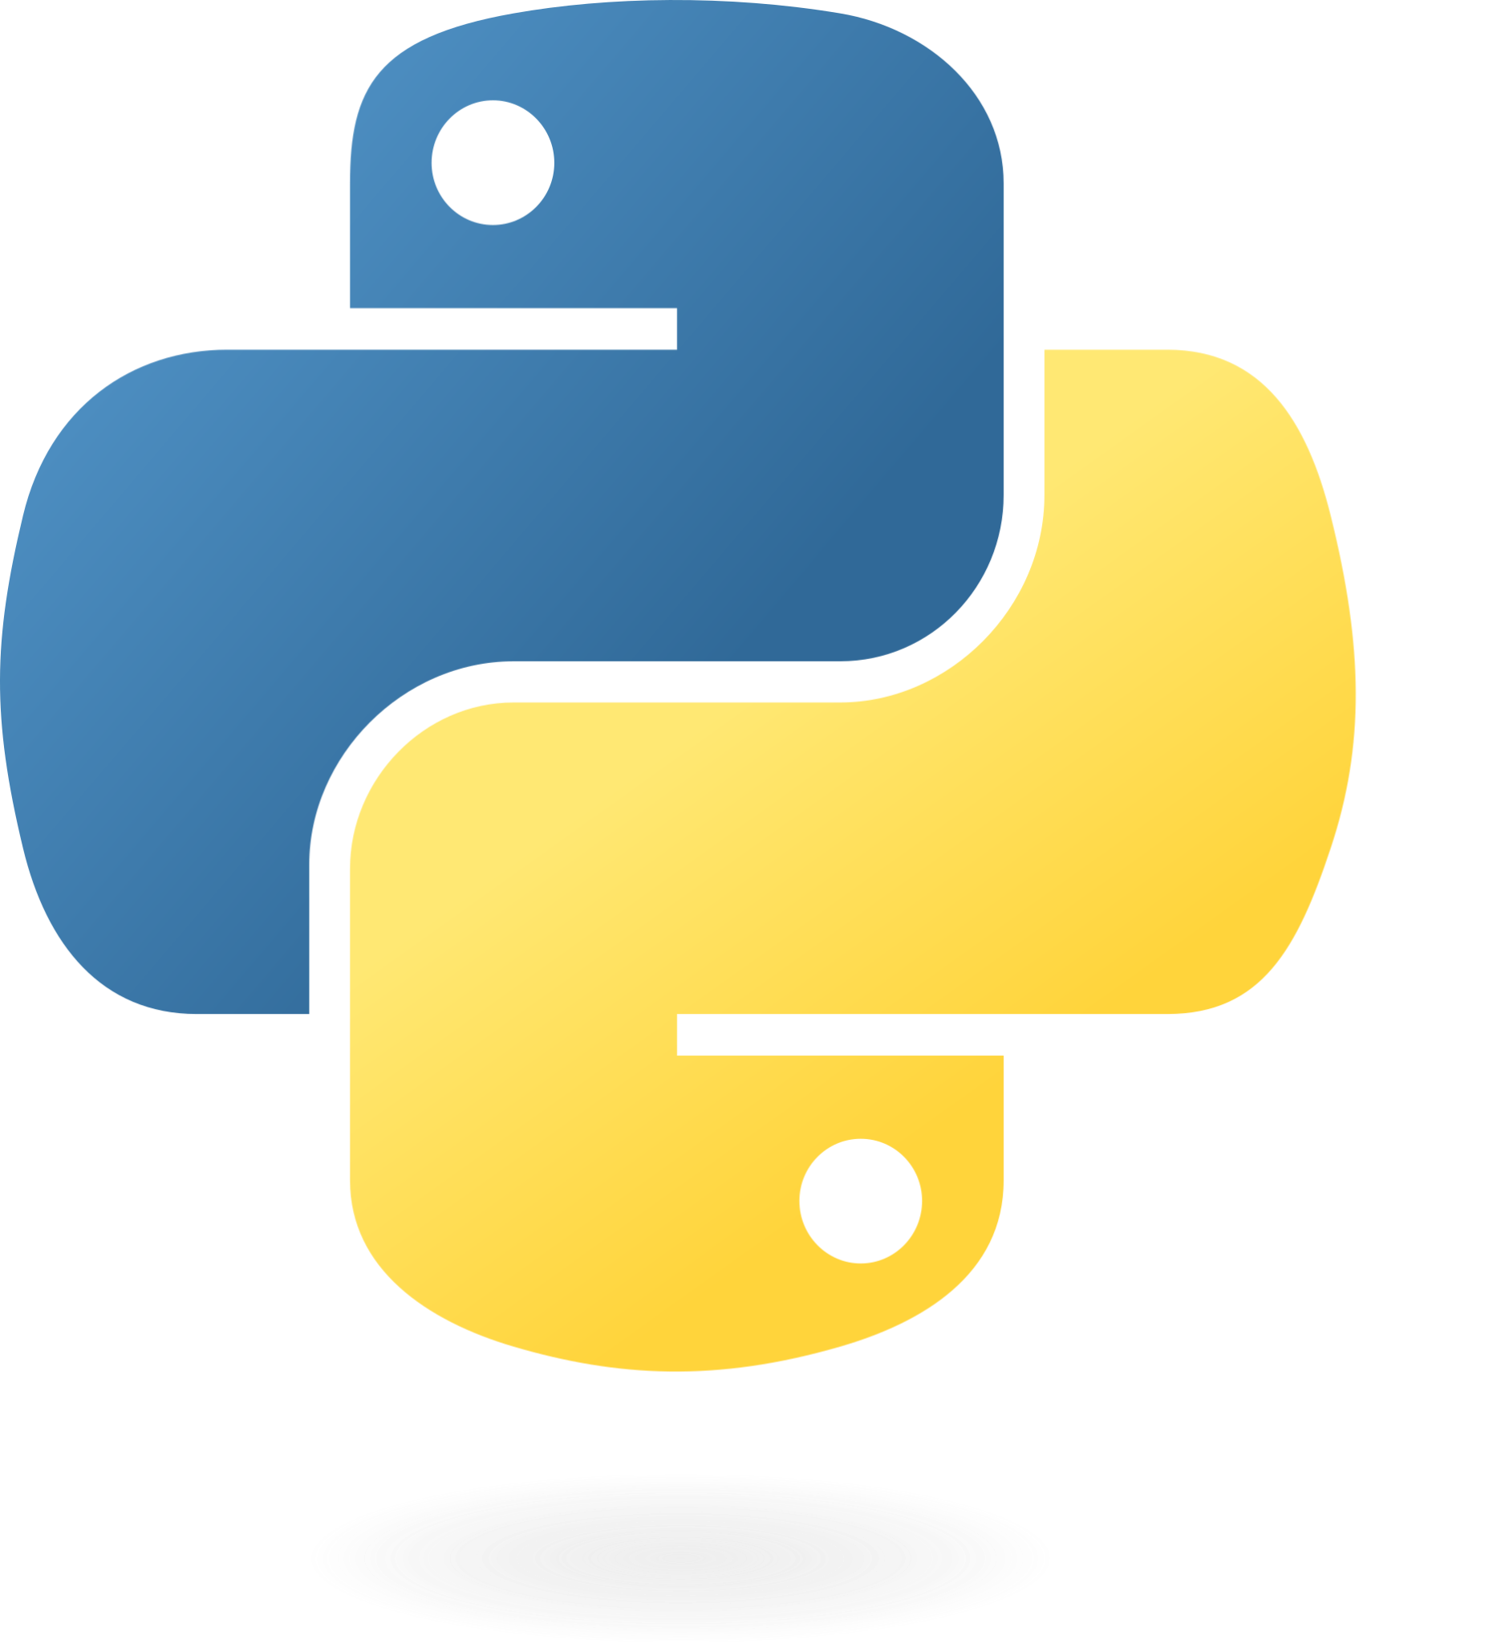
Project Specifications
Hardware Software
Microcontroller: Raspberry Pi Model 4 B - OS: Bookworm (Raspberry Pi)​
Touchscreen-based Device: Raspberry Pi Screen 7 in. Monitor - Language Used: Python​
Camera: Arducam Pi Camera Module IMX708 - Touchscreen UI: Pygame​
Motor Driver: L298N Motor Driver - Communication Protocols: IP Address​
Motors: DC motors - Motor Control Libraries: RPi.GPIO Library​
Chassis: 2WD Robot Car
Power Supply: Battery Pack (5V/12V)
Connectors/Wiring: Jumper Cables​
WiFI: Built-in (Raspberry Pi)​
​

Slide 7
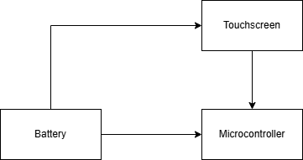
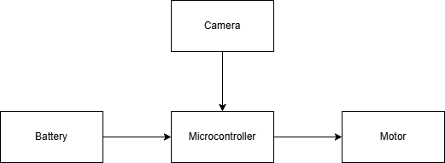
Design Solution
Touchscreen Device Block Diagram
Robotic Vehicle Block Diagram

Slide 8
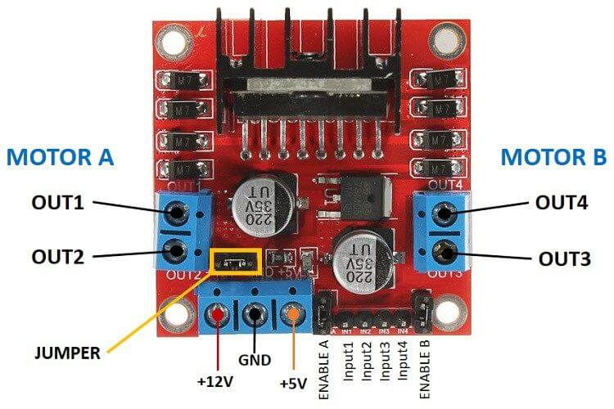
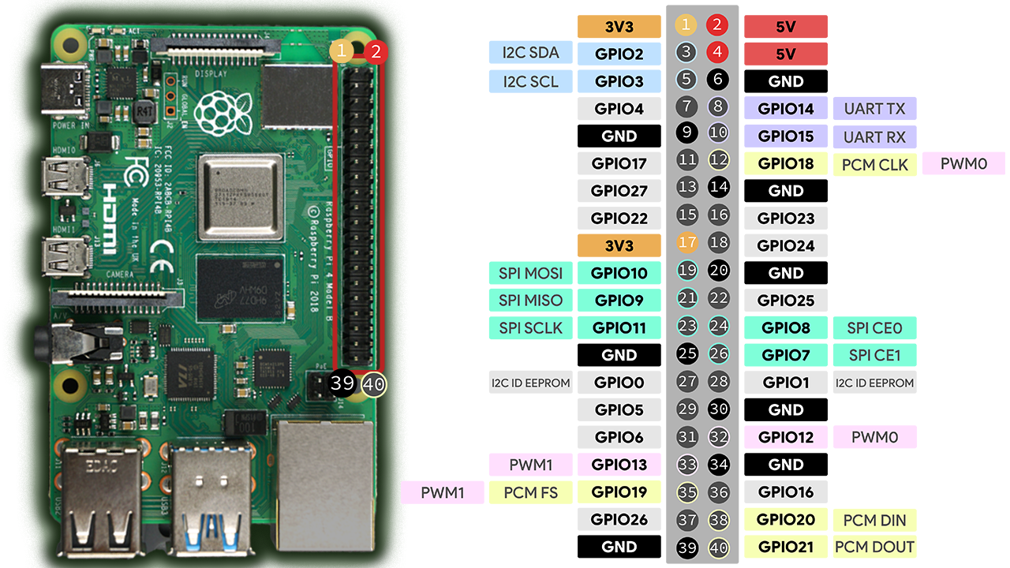
Robotic Vehicle Designs
Figure 4: L298N Motor Driver
Figure 5 : Raspberry Pi 4 Model B Pinout
Connected Pins:
Pin 6 connected to GND of L298N
Pin 13 (GPIO 27) - ENA
Pin 18 (GPIO 24) - ENB
Pin 11 & 12 (GPIO 17 & 18) - IN1 & IN2
Pin 15 & 16 (GPIO 22 & 23) - IN3 & IN4
Motor A & B are connected individually to the two motors of the vehicle.
Note: In case if you are wondering what ENA and ENB they are to enable the motors in which ENA enable Motor A and ENB enable Motor B.
In addition, the IN1-4 are factors of controlling the movement of the wheel. For example if we set IN1 to HIGH it will move the left wheel forward if we set it to LOW it will not move.

Slide 9
Connectivity between Two Microcontrollers
To connect between the two microcontrollers, we needed to get the IP address of the microcontroller, which is the Robotic Vehicle microcontroller.
Once the Robotic Vehicle IP address is acquired, we connect to the IP and then can start to move the robotic vehicle around.
Note: Some difficulties that we ran into for the connections were when we were on campus which when connecting through IP, it wouldn’t allows us to move the robotic vehicle or even connect to it.

Slide 10
Cost Budget
Material/Parts | Quantity | Cost
Microcontroller | 2 | $70.00
Touchscreen Device | 1 | $39.99
Battery | 2 | $33.98
Robotic Vehicle Frame + Motor | 1 | $20.99
Camera | 1 | $23.99
Total |  | $188.95
Note:
The overall cost for to the materials would be $188.95.
If we were to include Personnel cost we would be over budget but as students we didn’t include the personnel cost but the cost would be $6,176.92 not including the spring semester (12 Weeks and 4 hrs).

Slide 11
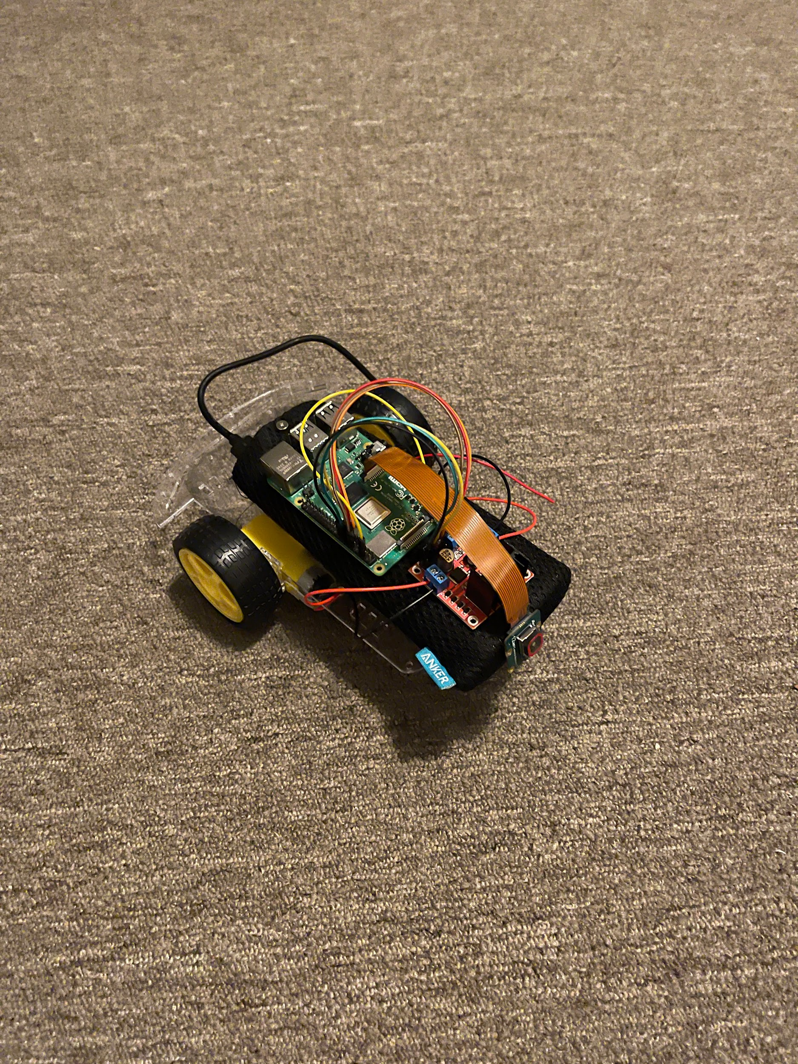
Project Demonstration

Slide 12
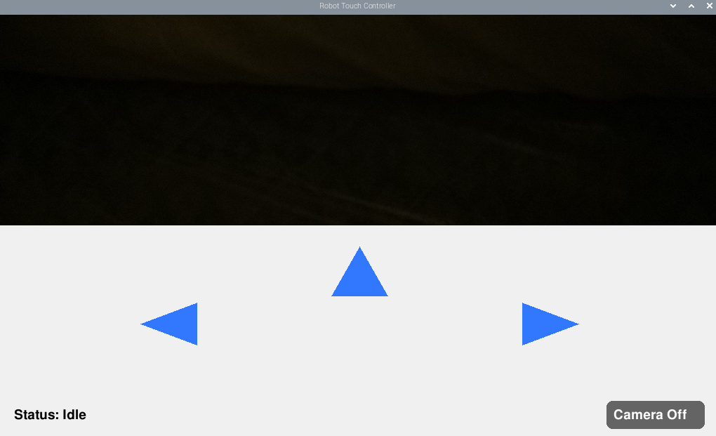
What’s in the Touchscreen GUI?

Slide 13
Additional Features
To further improve the functionality and safety of the robotic vehicle, the following features could be added in future iterations:
Obstacle Detection Sensors Add ultrasonic or infrared sensors to detect and avoid obstacles in real-time.
GPS Module Equip the robot with a GPS module for outdoor navigation and tracking.
Autonomous Navigation Implement path planning algorithms to allow the robot to move on its own without manual control.
Speech Feedback or Voice Commands Enable voice control or add a speaker for audible alerts and status updates.
Battery Monitoring System Include a module to monitor power levels and notify users when recharging is needed.
These enhancements would make the robot more intelligent, autonomous, and better suited for real-world applications like search and rescue, surveillance, or hazardous area inspection.

Slide 14
Conclusion
In conclusion, the project was successful and were able to hit the customer’s requirements. As of now, the project itself is a working prototype but we feel that further improvements can be made onto the project in the future. Overall, the project itself was fun and challenging at the same time. Things that we take into consideration is how much this project can be something that might or will be implemented into the future as technology itself grows.

Slide 15

Acknowledgement
Dr. Hadil Mustafa
Dr. Reza Khani
Some acknowledgement, we want to say is thank you Dr. Hadil Mustafa for EECE-490 AW and Dr. Reza Khani for EECE-490 B and also being our Faculty Advisor and believing in the two of us as we were doing this project.

Slide 16
Key resources:
https://www.zdnet.com/article/how-to-add-a-touchscreen-to-your-raspberry-pi-projects/
https://www.raspberrypi.com/documentation/accessories/display.html
Auer, Thomas, Simon Haller-Seeber, and Thomas Gatterer. “User Experience Design of Further Training on Test Automation of an AI Self-Driving Robotic Car Powered by a Raspberry Pi.” 2023 IEEE Global Engineering Education Conference (EDUCON). IEEE, 2023. 1–10. Web.
Mainampati, Manasa, and Balasubramaniyan Chandrasekaran. “Manual and Autonomous Mode Based Navigation Using Human Robot Interaction on a Robotic Vehicle.” 2020 11th IEEE Annual Information Technology, Electronics and Mobile Communication Conference (IEMCON). IEEE, 2020. 0559–0564. Web.

Slide 17
Thank You
&
Any Questions

